Slide 1
PN limitation data explanations/reasoning for Chris
Friday April 29, 2022

Slide 2
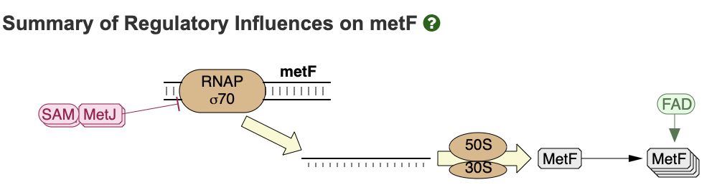
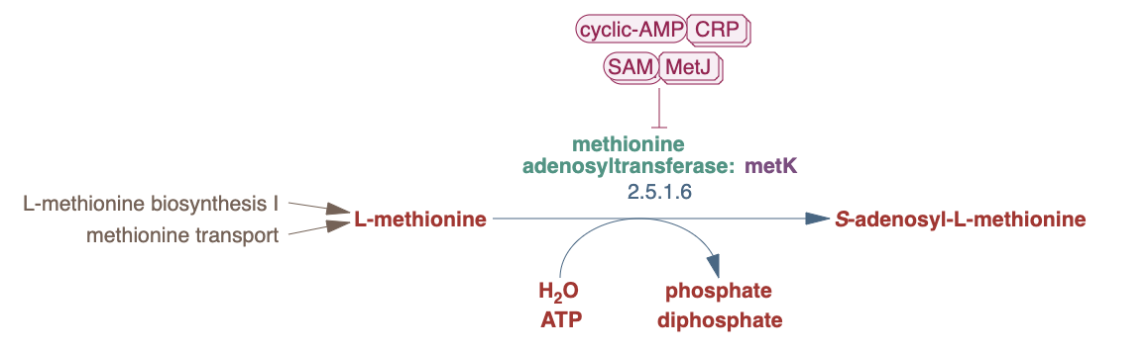
MetF
Idea: regulation of metF depends on SAM pools → SAM pools depend on PLP (due to PLP-dependent enzyme MetC)
Increase in SAM levels → Decrease in metF expression
Decrease in SAM levels → Increase in metF expression (PN limitation)
This would suggest SAM levels are down →
SAM levels are dependent on L-Met levels, which are dependent on L-Cys pathway
Difficult to reason:
Several PLP-DE’s are involved in AA biosynthesis
We would predict L-Met would be down, but it’s increased
metK expression doesn’t change; metJ expression decreases → difficult to reason why

Slide 3
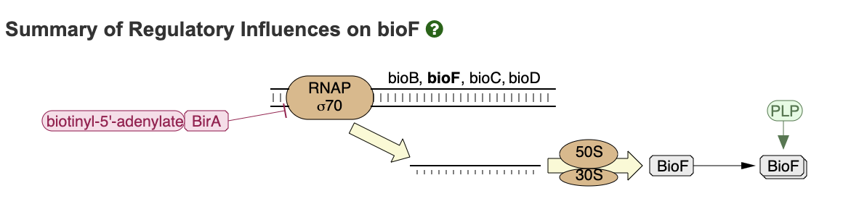
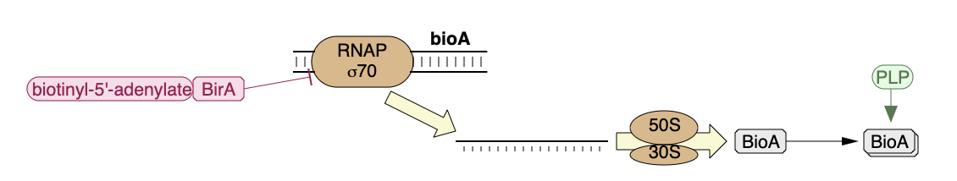
BioF
Reasoning:
2 PLP-DEs are involved in biotin biosynthesis
When PN is low, biotin levels should be low
When Biotin is low bioF and bioA are not repressed, so will have increased expression
Notes:
So we think low PLP is reducing the efficiency of bioF and bioA genes, leading to reduced biotin, which leads to increased expression of biotin synthesis genes.
-futile upregulation

Slide 4
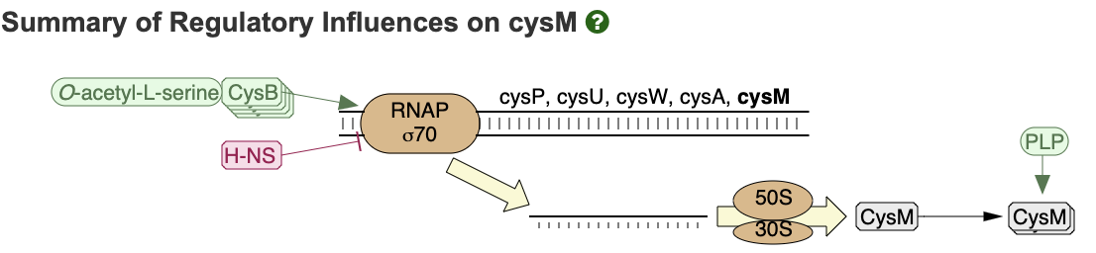
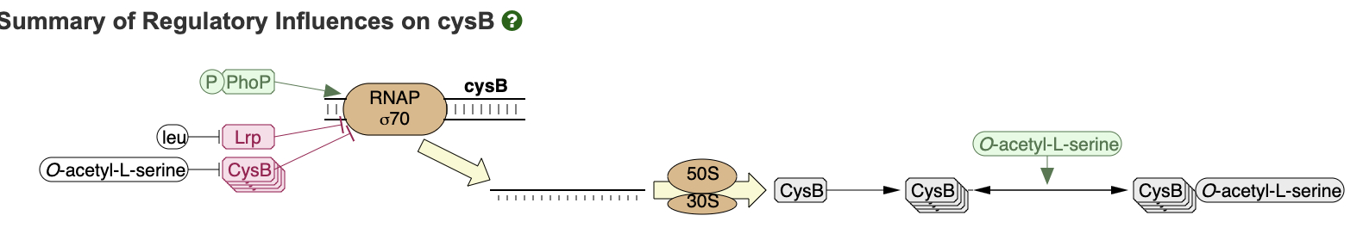
Cys genes
Reasoning:
High serine levels (metabolomics), could lead to high O-acetyl-L-serine → which would lead to increased expression of cys genes
Notes:
Cyc biosynthesis genes are impacted by low PLP, which may lead to low cysteine, but also serine is high which will lead to high o-acetyl-L-serine which up-regulates the cysteine pathway.
-combination of futile upregulation
-upregulated response to other metabolite accumulation

Slide 5
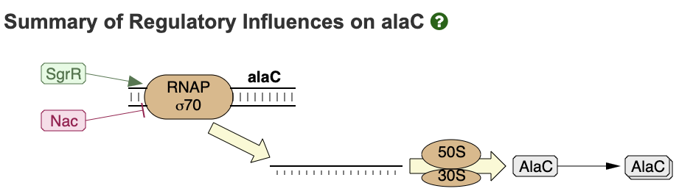
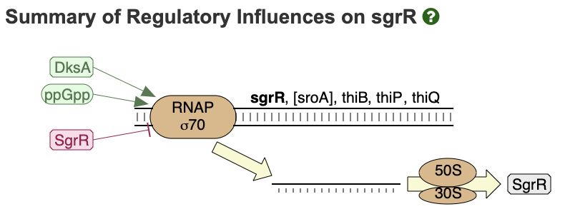
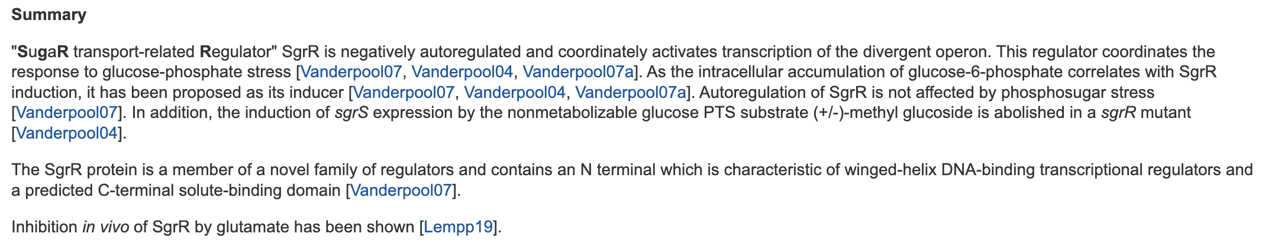
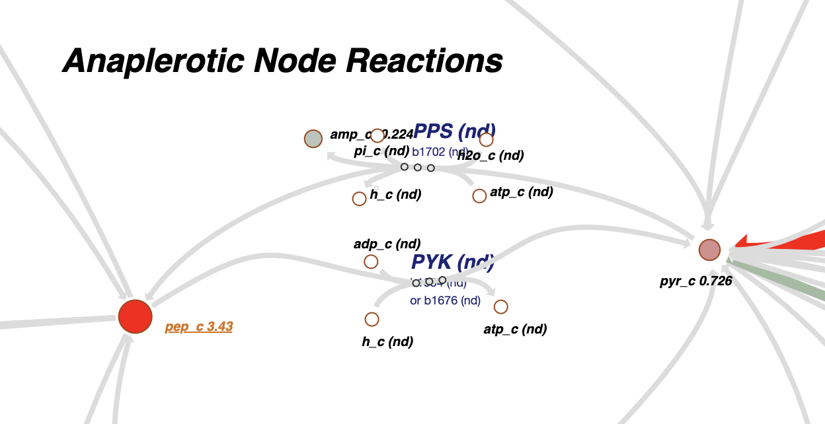
AlaC (PEP and sugar-phosphate stress)
jhljhkh
Glucose 6-P is a little high (ns)
PEP is high (very)
Glucose is low (very)
Glutamate is high (very)
→ Difficult to reason which direction SgrR regulation would/wouldn’t happen
Notes:
Ala is high… and it’s the product of this reation. This reaction may be going in reverse and working against a gradient?
-network effect

Slide 6
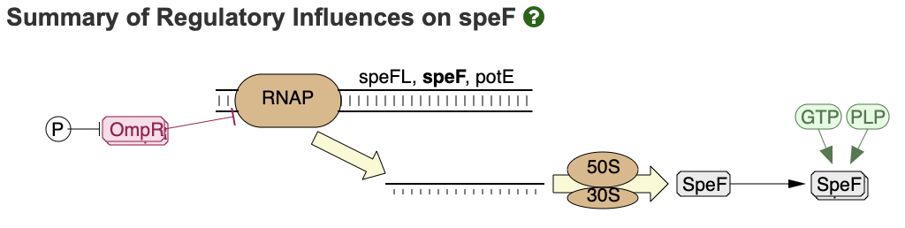
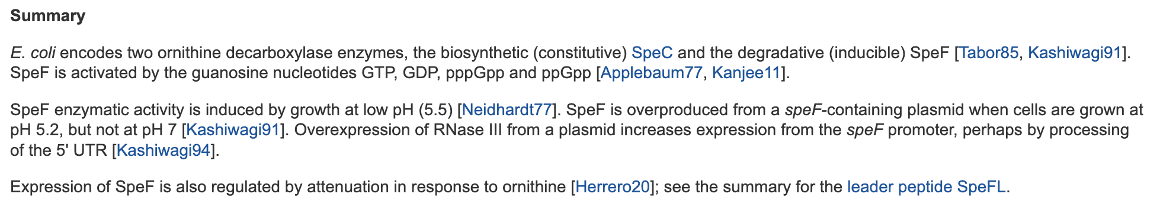
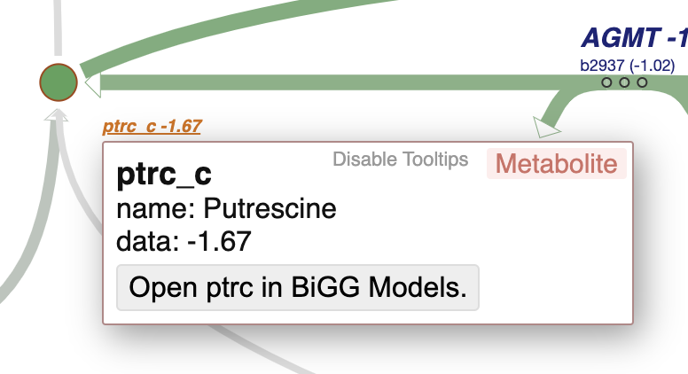

Spe genes (putrescine)
SpeF
SpeF
PLP-dependent enzyme
We see the substrate (ornithine) go up and the product (putrescine) go down
Notes:
-Low PLP impacts speF, leading to decreased putrescine and increased ornithine, and then futile upregulation to attempt to balance the effect
-futile upregulation

Slide 7
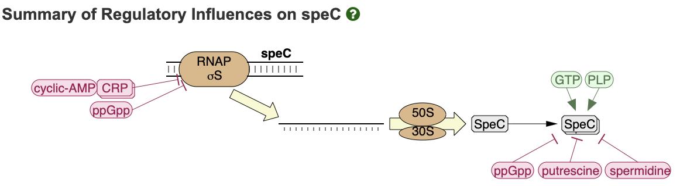
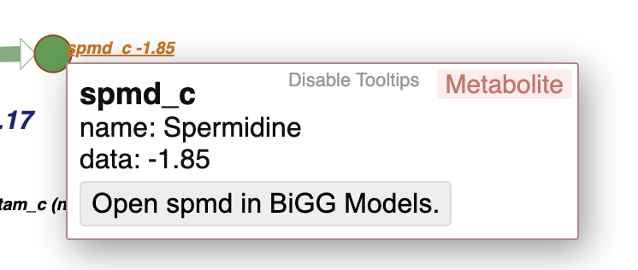
Spe genes (putrescine)
SpeC
SpeC expression is down
- Putrescine and spermidine are low… this suggests that:
ppGpp could be high
It’s cAMP-CRP related regulation
Can’t reason at this stage
Notes:
Regulation of this gene is different and we can’t explain…

Slide 8
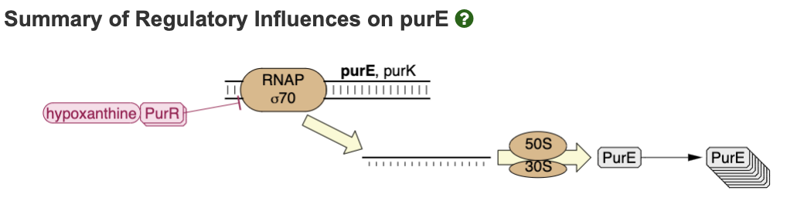
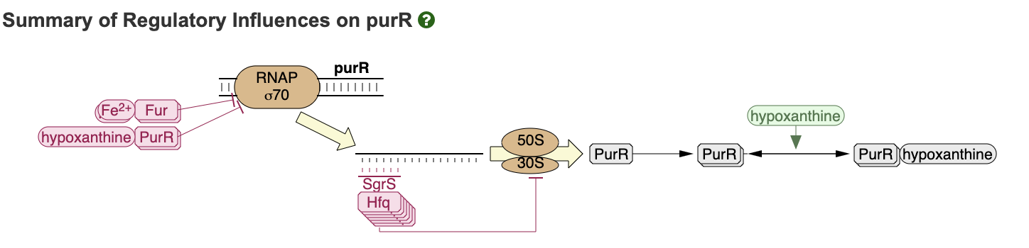
“Pur” gene expression is significantly decreased during PN limitation (same conditions as above)
Guanine is low; purR is low
Would expect expression of other pur genes to go up, but it goes down
Can’t reason this yet
Notes:
Guanine and PurR are low… so these should be overexpressed…
down regulation -> flux is down
Exploring glucose fluxotype of E. coli y-ome using high-throughput fluxomics

Slide 9
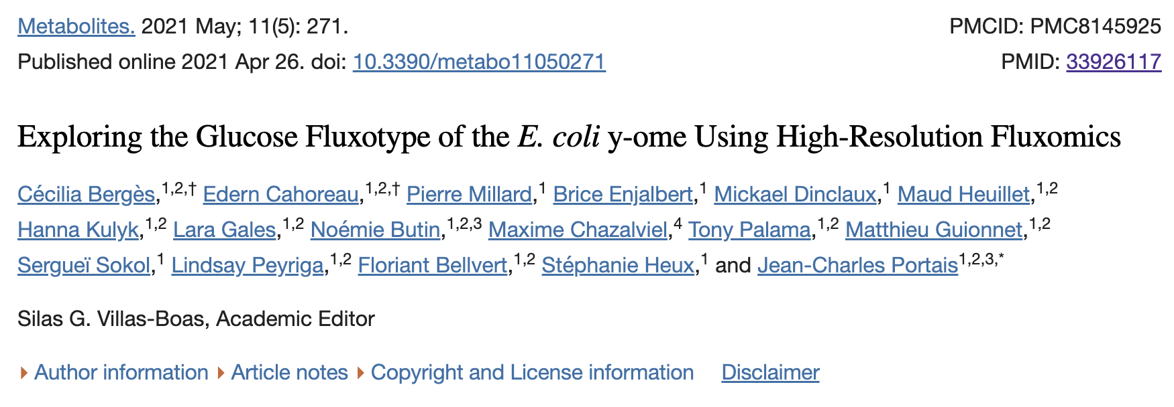
Down the line we should compare what happens in this paper to what we see in the model (ydcSTUV operon is PN transporter candidate genes)

